Slide 1
New Arts,Commerce & Science College,Ahmednagar
Forest Cover Area In India

Slide 2

GROUP - 6
HOD – Gangarde Sir
GUIDE BY– PROF.PATIL MAM
KARALE TEJAS
DESHMUKH SURAJ
GHORAPADE TEJAS
GIRAWALE SANKET
LATE SARTHAK
BHAPKAR ROHAN

Slide 3
CONTEXT
HOME:
INTRODUCTION:
2019 DATA: INFORMATION OF FOREST TYPES
2019 GRAPHS
2021 DATA:INFORMATION OF FOREST TYPES
2021 GRAPHS

Slide 4
INTRODUCTION
FOREST SURVEY WAS CONDUCTED IN EVERY 2 YEARS
We Are Taking The Data Of Year 2019 & 2021
Forest cover is the total geographical area declared as forest by the government. As of 2021, the total forest cover in India is 80.9 million hectares , which is 24.62 percent of the total geographical area.^{[2]} There is a 1,540 sq.km increase in forest cover over 2019. Madhya Pradesh has the highest forest cover as per the area followed by the Arunachal Pradesh. Mizoram has the highest forest cover in terms of percentage of total geographical area.
Ministry of the environment forest and climate change used the mid resolution satellite data on LISS-III data from Indian remote sensing satellite. Minister of environment forest and climate change Bhupendra Yadav released the Indian forest survey report 2021-22 on the 13 January 2022.
As per the report, 17 Indian states have a forest cover over 33%.

Slide 5
2019 Forest Cover Area By State
 |  | STATES | G.AREA | VERY DENSE FOREST | MOD.DENSE FOREST | OPEN FOREST |  | TOTAL FOREST
 | 1 | MAHARASHTRA | 3,07,713 | 8,734 | 20,589 | 21,475 |  | 50,798
 | 2 | MIZORAM | 21,081 | 157 | 5,715 | 11,948 |  | 17,820
 | 3 | ARUNACHAL PRADESH | 83,743 | 21,058 | 30,176 | 15,197 |  | 66,431
 | 4 | MEGHALAYA | 22,429 | 560 | 9,160 | 7,326 |  | 17,046
 | 5 | MANIPUR | 22,327 | 905 | 6,228 | 9,465 |  | 16,598
 | 6 | NAGALAND | 16,579 | 1,272 | 4,449 | 6,530 |  | 12,251
 | 7 | LAKSHADEEP | 30 | 0 | 16.09 | 11.01 |  | 27.1

Slide 6
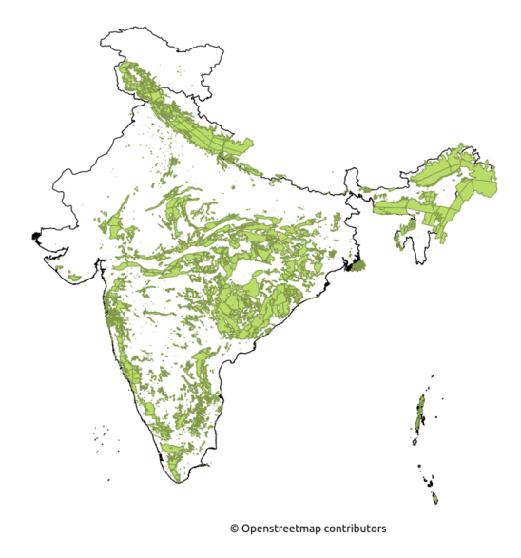

Slide 7
2019 Information
Forest cover: Includes all lands having trees more than one hectare in area with tree canopy density of more than 10%, irrespective of ownership, legal status of the land and species composition of trees.
Very Dense Forest: All lands with tree canopy density of 70% and above. The relative composition of forest cover under this category is 3.02%
Moderately Dense Forest: All lands with tree canopy density of 40% and more but less than 70%. Forest cover under this category is 9.39%
Open Forest: All lands with tree canopy density of 10% and more but less than 40 %. Forest cover of 9.26% falls under this category.
Scrub Forest: Lands with canopy density less than 10%. Geographical area under this category is 1.41%.
Non-forest: Lands not included in any of the above classes (includes water). Geographical area under the non-forest category is 76.92%.
Largest forest cover in India: Madhya Pradesh > Arunachal Pradesh > Chhattisgarh > Odisha > Maharashtra
Forest cover as percentage of total geographical area: Mizoram (85.41%) > Arunachal Pradesh (79.63%) > Meghalaya (76.33%) > Manipur (75.46%) > Nagaland (75.31%).

Slide 8
GRAPH 2019

Slide 9
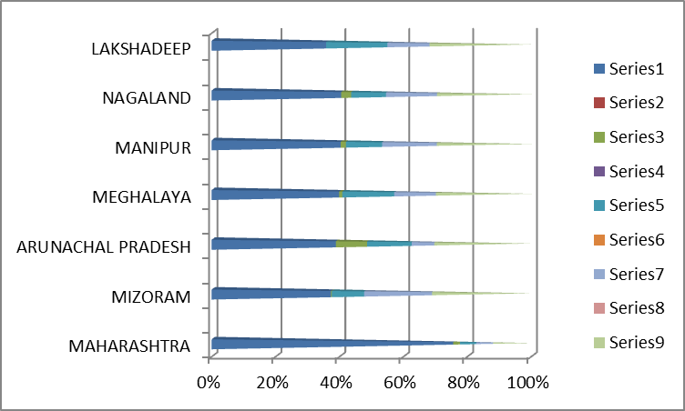

Slide 10
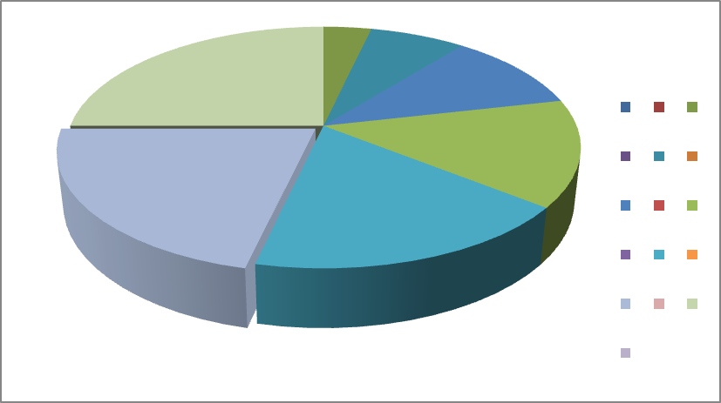
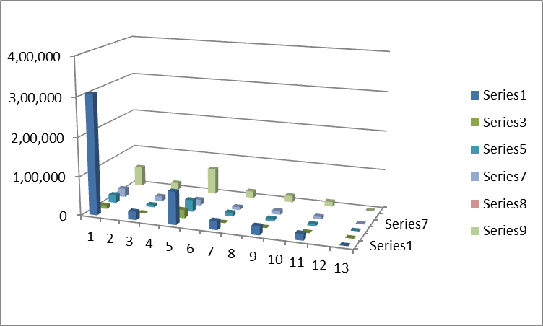

Slide 11
2021 Forest Cover Area By State

Slide 12
2021 Information
Forest cover: Includes all lands having trees of more than one hectare in an area with a tree canopy density of more than 10%, irrespective of ownership, the legal status of the land, and species composition of trees.
Very Dense Forest: All lands with tree canopy density of 70% and above. The relative composition of forest cover under this category is 3.04%
Moderately Dense Forest: All lands with tree canopy density of 40% and more but less than 70%. Forest cover under this category is 9.33%
Open Forest: All lands with tree canopy density of 10% and more but less than 40 %. The forest cover of 9.34% falls under this category.
Scrub Forest: Lands with canopy density less than 10%. The geographical area under this category is 1.42%.
Non-forest: Lands not included in any of the above classes (includes water). The geographical area under the non-forest category is 76.87%.
Largest forest cover in India: Madhya Pradesh > Arunachal Pradesh > Chhattisgarh > Odisha > Maharashtra

Slide 13
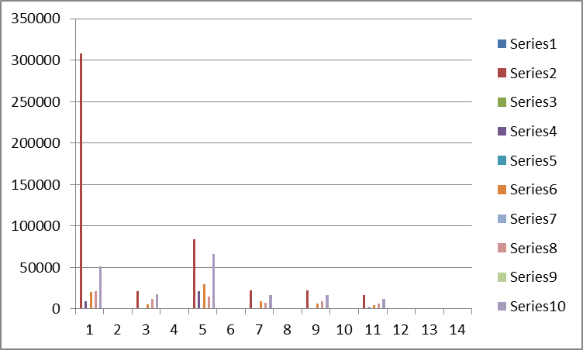
GRAPH 2021

